Slide 1
DATABASE FUNDAMENTALS

Slide 2
DBMS
It is responsible for creating, editing, deleting and generally maintaining a database or collection of data records.
A database model is the manner in which the data collection is stored, managed and administered.
Different data models:
Flat file based database management systems
Hierarchical database management systems
Network database management systems
Object oriented database management systems
Relational database management systems

Slide 3
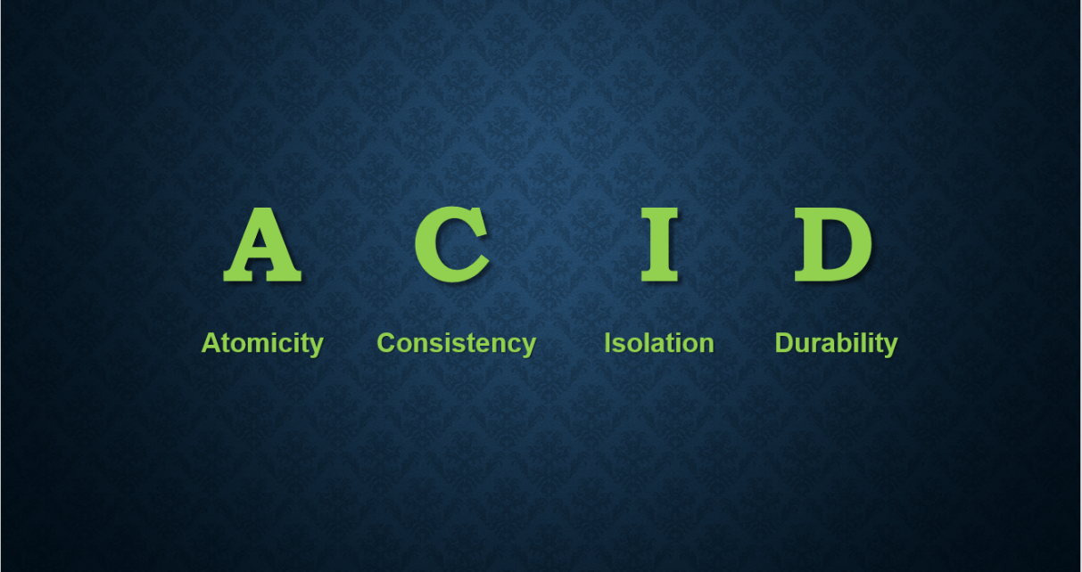
File based approach Disadvantages:
Integrity problems
Concurrent access
Data redundancy
Data Inconsistency
Atomicity Problems
DBMS advantages:
Inconsistency
Integrity
Recovery services.
Controlling Redundancy
Restricting unauthorized access
Concurrency Control
ACID PROPERTIES:

Slide 4
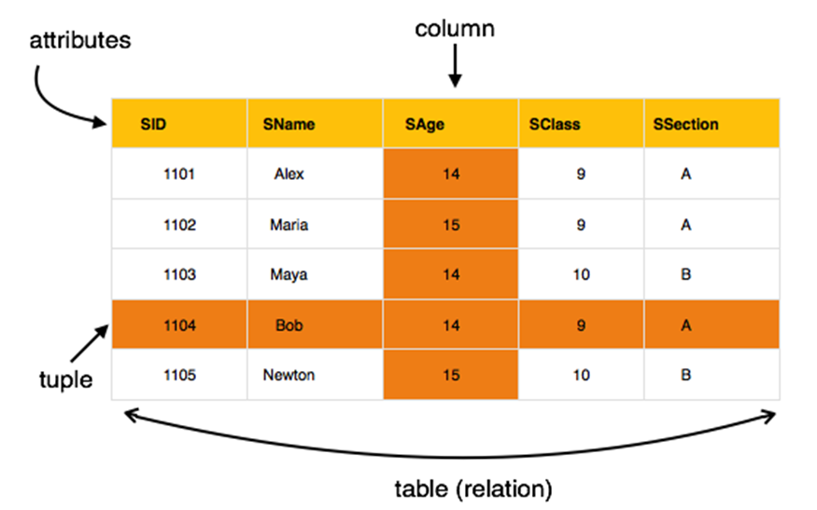
RDMS
Null constraint
Not null constraint
Unique constraint
Default constraint
Primary key constraint
Foreign key constraint

Slide 5
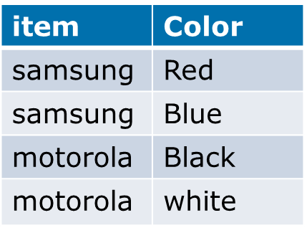
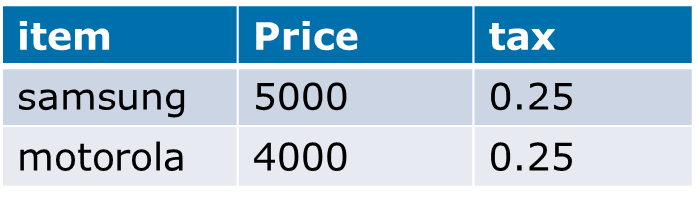
Normalization
1 NF
item | Color | Price | tax
samsung | red, blue | 5000 | 0.25
motorola | Black, white | 4000 | 0.25
item | Color | Price | tax
samsung | Red | 5000 | 0.25
samsung | Blue | 5000 | 0.25
motorola | Black | 4000 | 0.25
motorola | white | 4000 | 0.25
2 NF

Slide 6
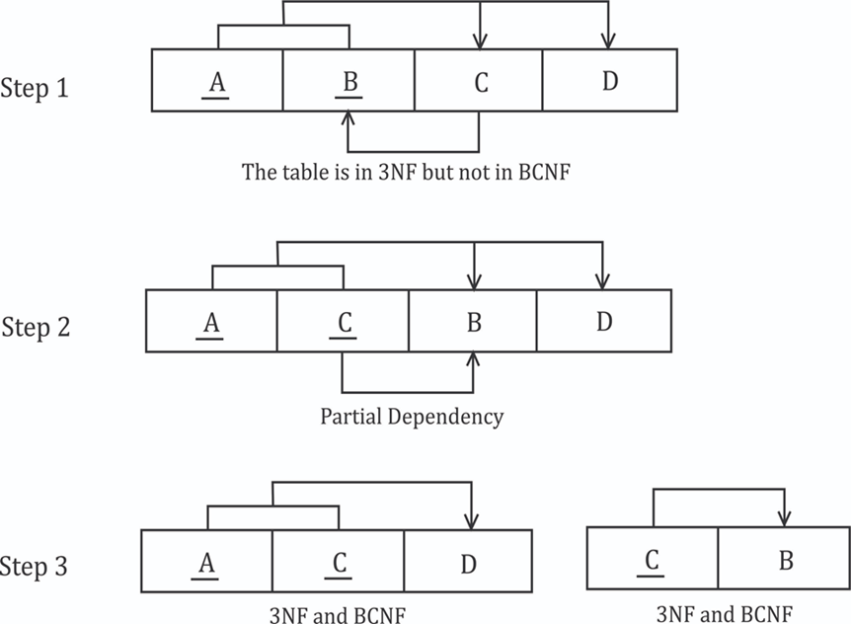
3 NF
BCNF
item | Color
samsung | Red
samsung | Blue
motorola | Black
motorola | white
item | Price
samsung | 5000
motorola | 4000
Price | tax
5000 | 0.25
4000 | 0.25

Slide 7
Structured query language SQL is a standard computer language for relational database management and data manipulation.
SQL language statement
DDL
DML
DCL
TCL
Create
Alter
Truncate
Drop
Insert
Update
Delete
Select
Grant
Revoke
Commit
Rollback

Slide 8
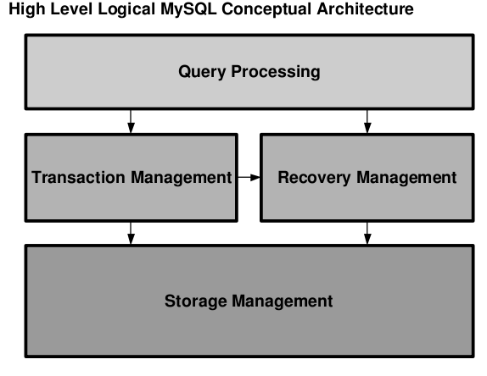
General RDBMS architecture
Application layer
Logical layer
Physical layer

